Slide 1
Probability Distribution:
Poisson distributions
By- Nupur Patel
22BT04075
2nd Sem
Mathematics - II

Slide 2
Introduction to the Poisson Distribution
Poisson distribution is for counts—if events happen at a constant rate over time, the Poisson distribution gives the probability of X number of events occurring in time T.

Slide 3
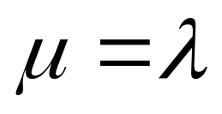
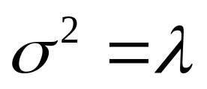
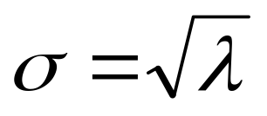
Poisson Mean and Variance
Mean
For a Poisson random variable, the variance and mean are the same!
Variance and Standard Deviation
where λ = expected number of hits in a given time period

Slide 4
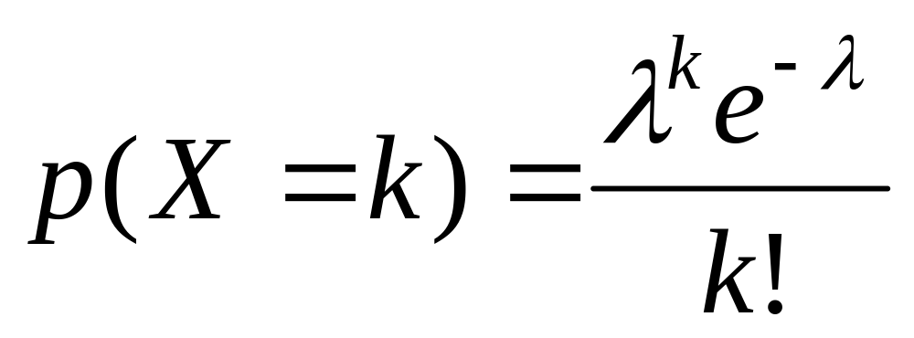
Poisson Distribution, example
The Poisson distribution models counts, such as the number of new cases of SARS that occur in women in New England next month.
The distribution tells you the probability of all possible numbers of new cases, from 0 to infinity.
If X= # of new cases next month and X ~ Poisson (λ), then the probability that X=k (a particular count) is:

Slide 5
Example
For example, if new cases of West Nile Virus in New England are occurring at a rate of about 2 per month, then these are the probabilities that: 0,1, 2, 3, 4, 5, 6, to 1000 to 1 million to… cases will occur in New England in the next month:

Slide 6
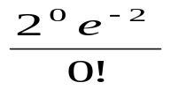
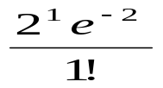

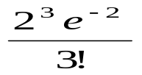

Poisson Probability table
X
P(X)
0
=.135
1
=.27
2
=.27
3
=.18
4
=.09
5
…
…

Slide 7
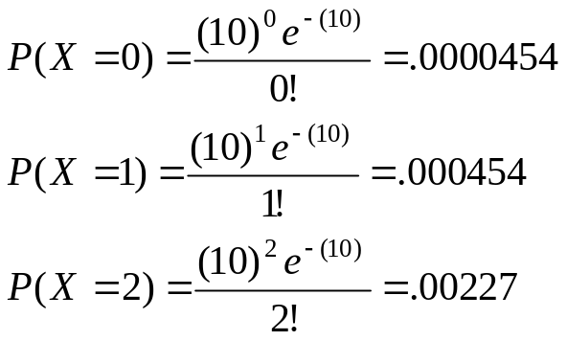
Example: Poisson distribution
Suppose that a rare disease has an incidence of 1 in 1000 person-years. Assuming that members of the population are affected independently, find the probability of k cases in a population of 10,000 (followed over 1 year) for k=0,1,2.
The expected value (mean) =λ = .001*10,000 = 10
10 new cases expected in this population per year→

Slide 8
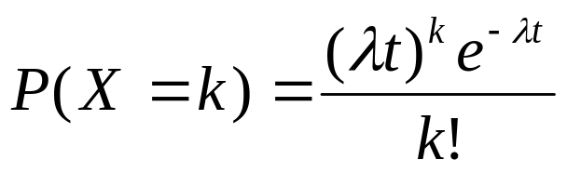
more on Poisson…
“Poisson Process” (rates)
Note that the Poisson parameter λ can be given as the mean number of events that occur in a defined time period OR, equivalently, λ can be given as a rate, such as λ=2/month (2 events per 1 month) that must be multiplied by t=time (called a “Poisson Process”) →
X ~ Poisson (λ)
E(X) = λt
Var(X) = λt

Slide 9
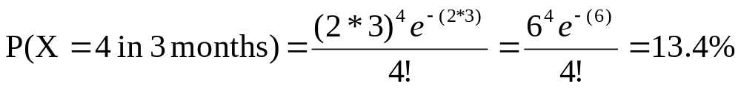
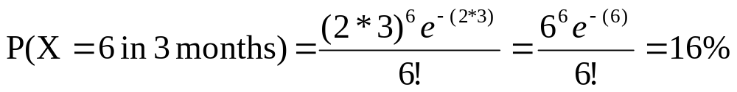
Example
For example, if new cases of West Nile in New England are occurring at a rate of about 2 per month, then what’s the probability that exactly 4 cases will occur in the next 3 months?
X ~ Poisson (λ=2/month)
Exactly 6 cases?

Slide 10
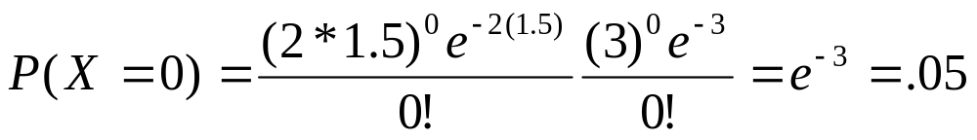
Answer
1a. If calls to your cell phone are a Poisson process with a constant rate λ=2 calls per hour, what’s the probability that, if you forget to turn your phone off in a 1.5 hour movie, your phone rings during that time?
X ~ Poisson (λ=2 calls/hour)
P(X≥1)=1 – P(X=0)
∴P(X≥1)=1 – .05 = 95% chance
1b. How many phone calls do you expect to get during the movie?
E(X) = λt = 2(1.5) = 3

Slide 11


